Slide 1
Topic: Time zones
New topic
EQ: How do we find the time difference between two places on Earth?

Slide 2
Learning objectives
Understand the link between longitude and time (ACMEM162)
Solve problems involving Greenwich Mean Time and International Date Line (ACMEM164)
Find time differences between two places on Earth (ACMEM165)
Solve problems relating to travelling east and west, incorporating time zone changes (ACMEM166)

Slide 3
2 minute Quick-Write: How do you locate a position on the Earth’s surface?

Slide 4
24
7
30
Topic: Time zones
Date
EQ – How do we find the time difference between two places on Earth?
A location’s time is determined by its longitude
All locations on the same longitude have the same time.
A 15 ֯ change in longitude corresponds to a 1 hour time difference
Notes:
Finding time using longitude:
Find the difference between the 2 longitudes
Remember if the locations are on opposite sides of the prime meridian you will need to add
2. Divide this time difference by 15 to give you the difference in hours
3. If you move east (west to east) you add hours. If you move west
(east to west) than you subtract the hours.

Slide 5

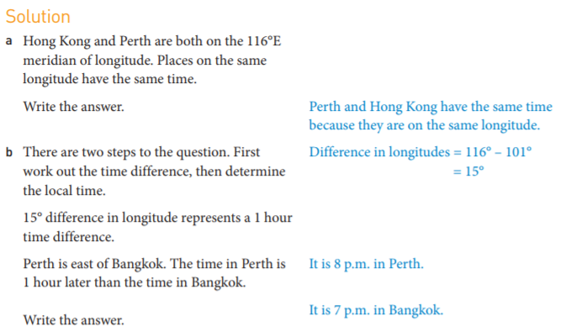
Example 1:

Slide 6
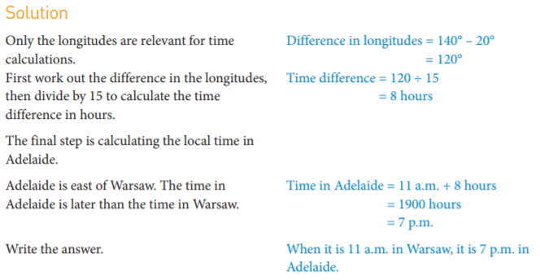
Example 2:

Slide 7
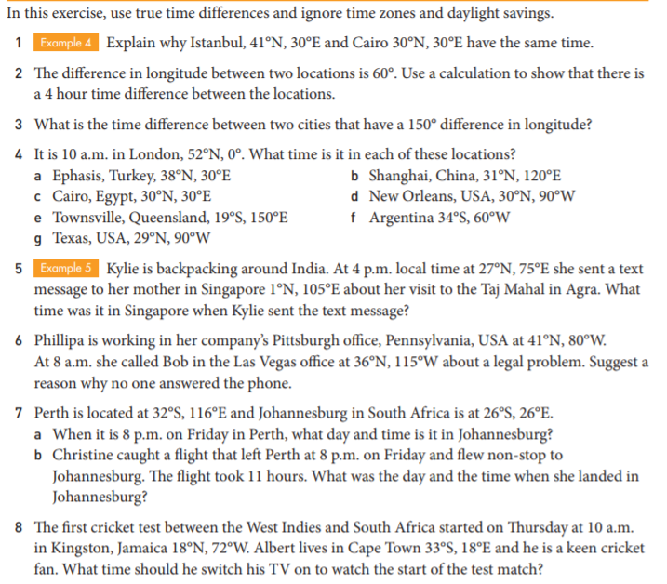

Slide 9
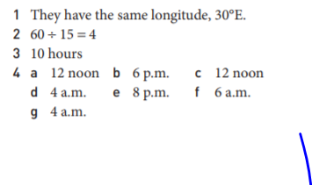
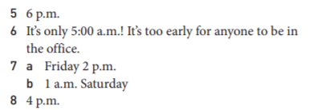

Slide 10
https://www.youtube.com/watch?v=kDWHM00sZJc
Watch-think-write (ensure you are pausing the video for students to form notes)
Turn-and-talk (students to collaborate to add to their notes

Slide 11
24
7
30
Topic: Time zones
Date
EQ – How do we find the time difference between two places on Earth?
Different parts of the world operate on different time zones
The time zones relate to Green Mean Time (GMT).
Cities to the west of London are behind of GMT
Cities to the east of London are ahead of GMT

Slide 12
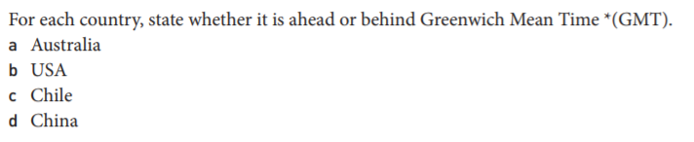
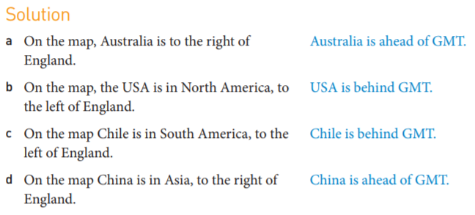
Example 1:

Slide 13

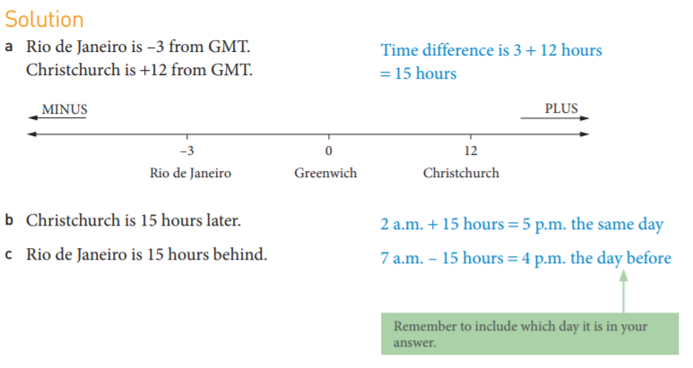
Example 2:

Slide 14
Task:
- Complete Longitude and Time zones ( need the associated time zone map)

